Slide 1
Effects of Training Sample Size on Photometric Redshift Error for LSST
Yilun Guan, Hongbo Cai

Slide 2
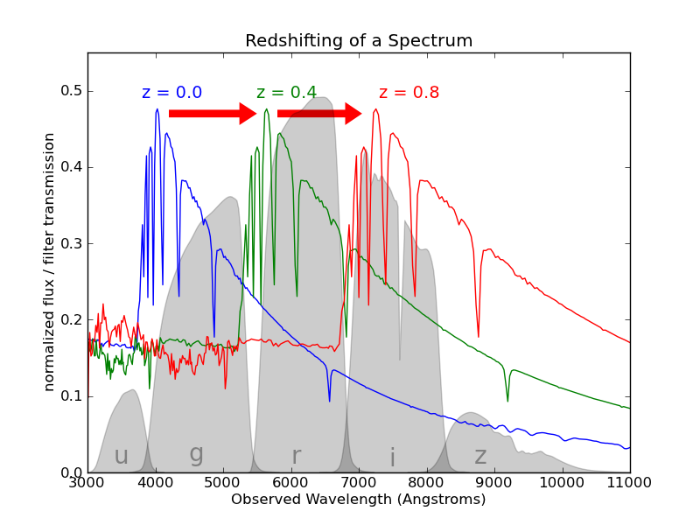
Photometric redshifts (photo-z)
Redshift determines how far in history is an astronomical object
Best measurements is through spectrography (spectro-z)
Time consuming: ~100 hours per redshift determination from spectroscopy
Photo-z measures redshift (z) without using spectrum
Use broad passband of colors to determine redshifts.
For example: ugriz
Pedregosa 2011

Slide 3
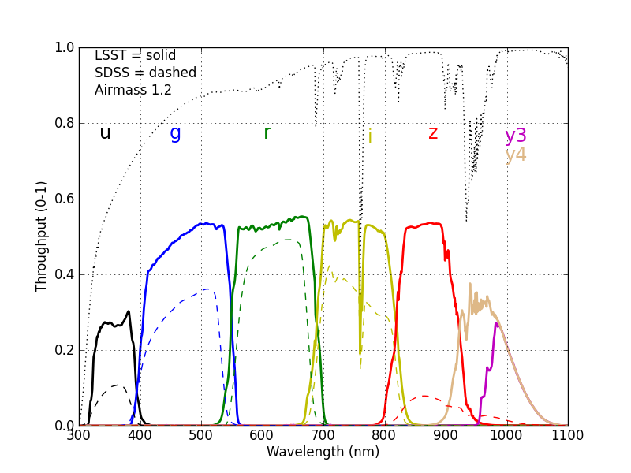
Large Synoptic Survey Telescope (LSST)
10-year survey with unprecedented coverage and depth
Scan entire sky every 3 nights
World largest camera: 10 billion pixels
6 standard broad passband: ugrizy
Able to detect > 4 billions of galaxies -> problem for spectroscopy
Take 50,000 years to measure their spectroscopy
Rely on photo-z for all cosmological science goals
Newman

Slide 4
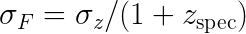
LSST photo-z requirements
In order to achieve LSST science goals, photo-z has to reach requirement level
Requirements:
Actual performance:
Simulation (perfect knowledge):
Outlier fraction: < 10%
Bias:
Takes time to prepare the training samples due to the depth and coverage of LSST
requires calibration
LSST Science Book V2.0

Slide 5
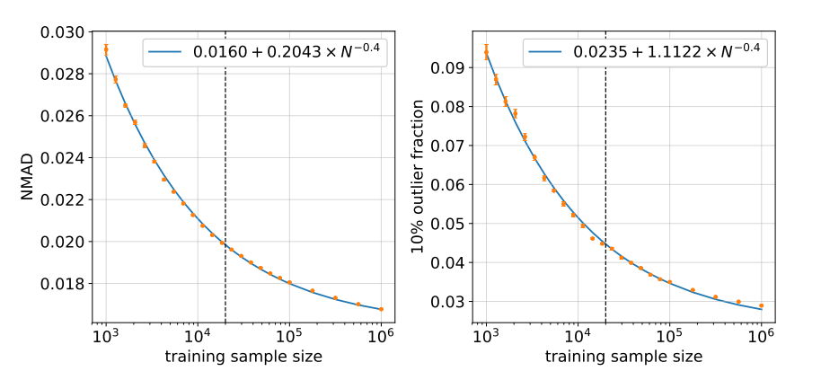
The scaling between photo-z estimation error with the training sample size seems to follow a simple power law:
Random forest
Different algorithms may scale differently with training samples
Newman 2019

Slide 6
Goal
Investigate if different MLs based photo-z algorithms follow similar power law
Study how photo-z estimation errors depend on training sample sizes
Study how fraction of outliers depends depends on training sample sizes

Slide 7
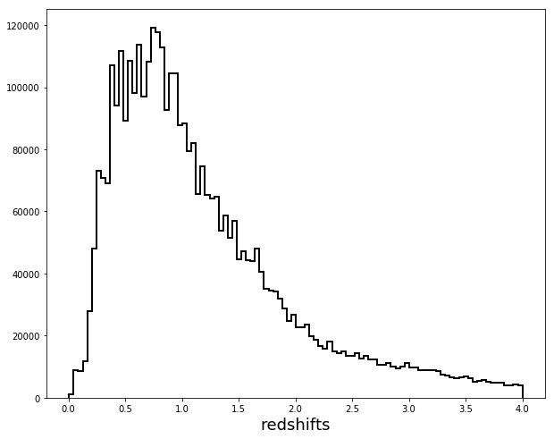
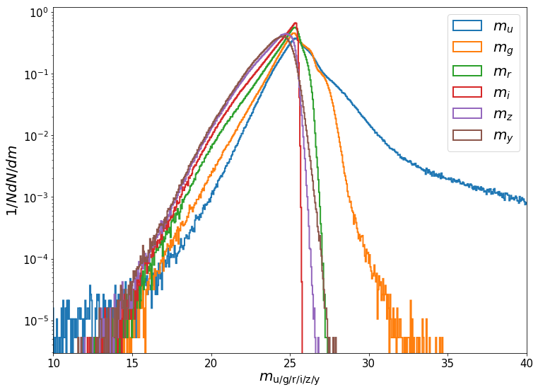
Data
Used the simulated LSST data in Melissa et. al. 2017
Magnitudes in ugrizy bands
Added noise to simulate telescope property to make data “realistic looking”
Melissa 2017

Slide 8
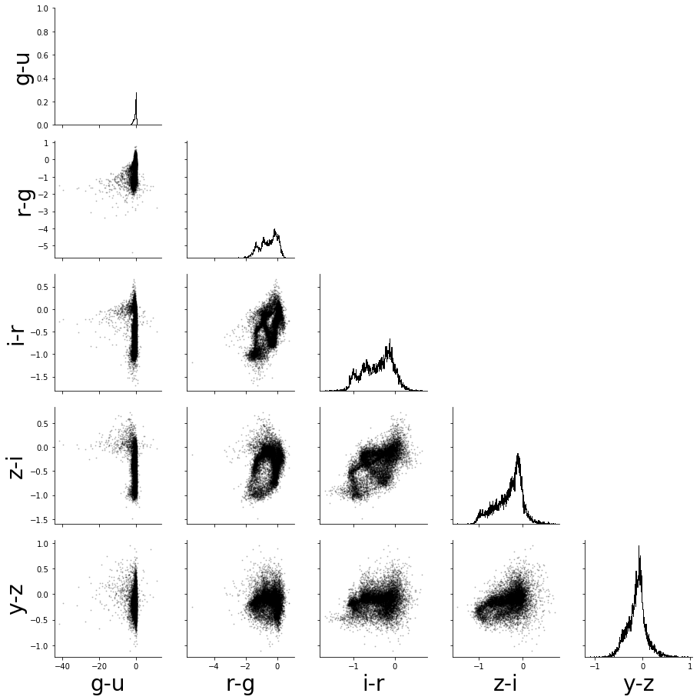
Correlated & non-Gaussian

Slide 9
Algorithms
Sklearn:
Random forest
K-nearest neighbours
XGBoost (not in sklearn but equivalent)
ANNz2:
Artificial neural network (ANN)
Boosted decision tree (BDT)
ANN + BDT mixture

Slide 10
Introducing to ANNz2
A new implementation of the public software for photometric redshift (photo-z)
Based on TMVA, a C++ ML package developed in Cern
Utilizes multiple machine learning methods
Includes artificial neural networks and boosted decision trees
genInputTrees train optimize evaluate

Slide 11
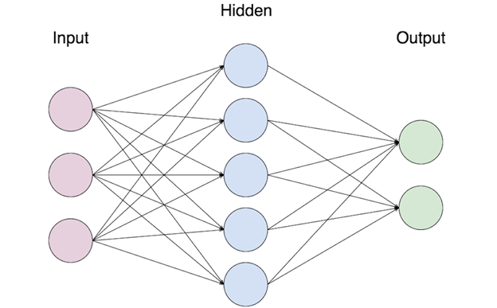
Artificial neural networks (ANN)
Mapping between a set of input variables and output variables
Input layer, hidden layer and output layer
Activation functions
Neurons

Slide 12
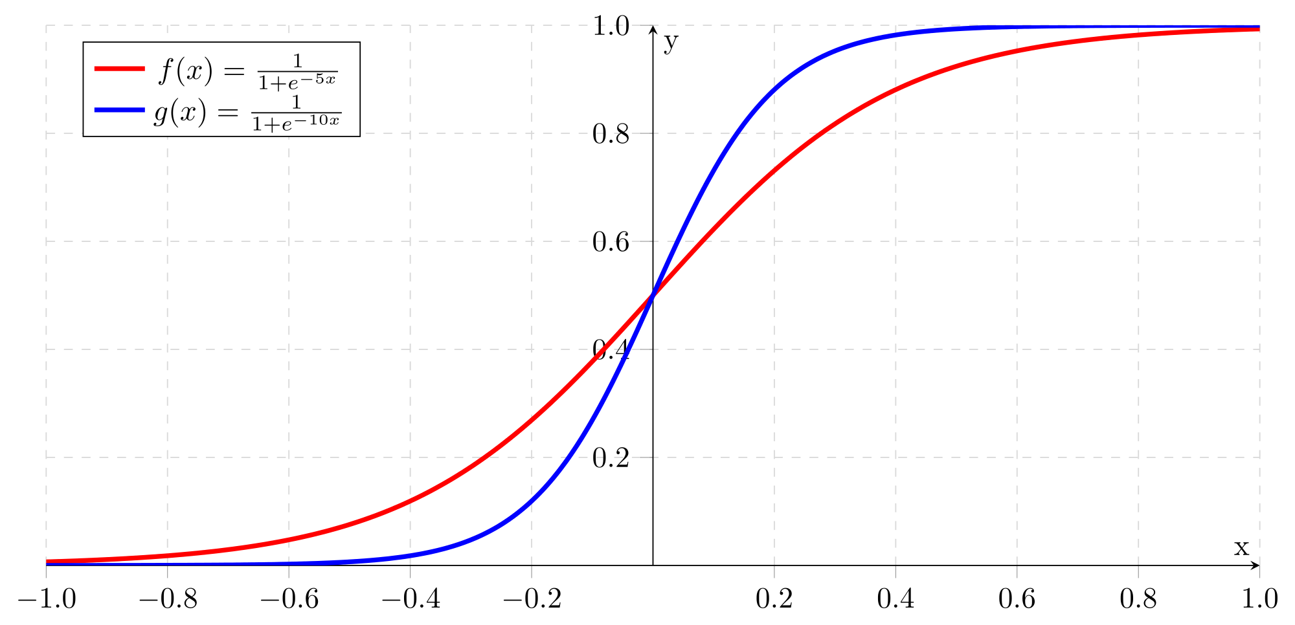
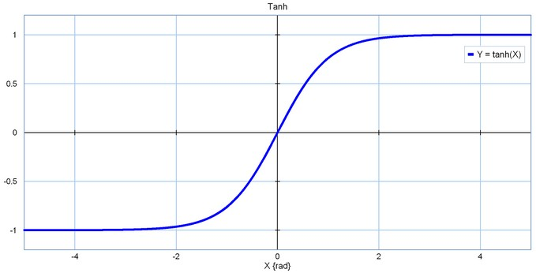
Activation functions of ANNs
Sigmoid function tanh function

Slide 13
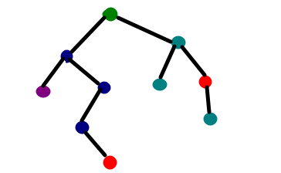
Boosted decision trees (BDT)
Decision tree
Sensitive to statistical fluctuation
A small change may affect subsequent nodes and the entire structure
It is therefore beneficial to use not a single tree, but a forest of trees

Slide 14
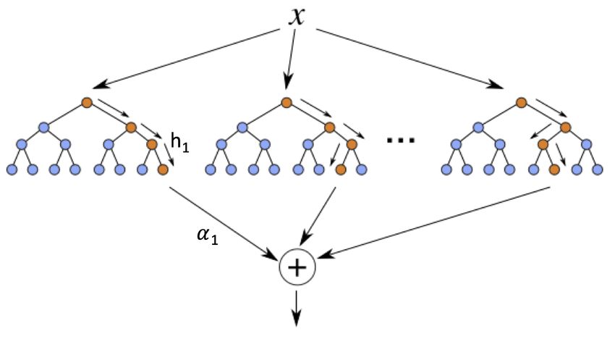
Boosted decision trees (BDT)
A forest of trees
Involves training multiple classifiers using the same data
The data are re-weighted differently for each tree
The combined estimator is then derived from the weighted majority vote of trees in the forest

Slide 15
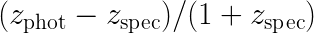
Methods
Training: varying sample sizes from 10^3 to 10^6
Testing: 10^5 randomly selected samples (non-overlapping with training samples)
Evaluate photo-z error with NMAD (normalized median absolute deviation) of
Fit power law with a least-square algorithm
Repeat for each ML algorithm

Slide 16
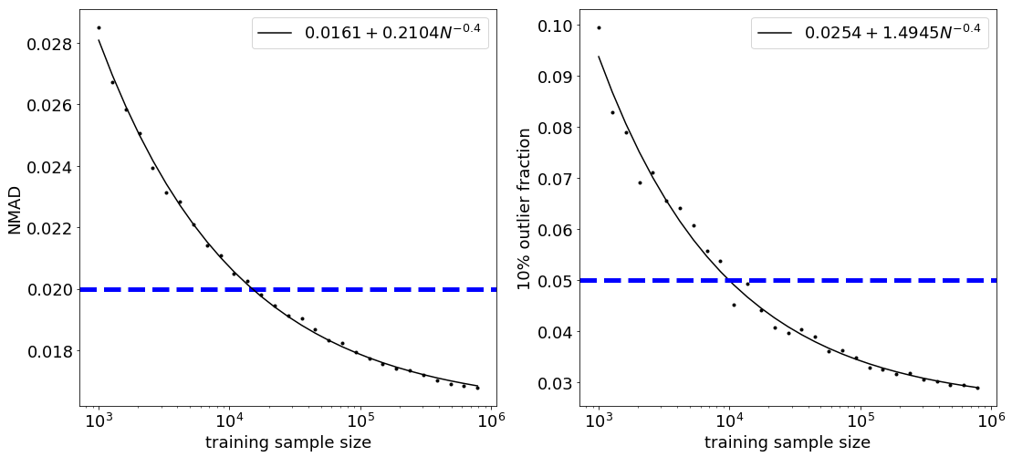
Results: random forest

Slide 17
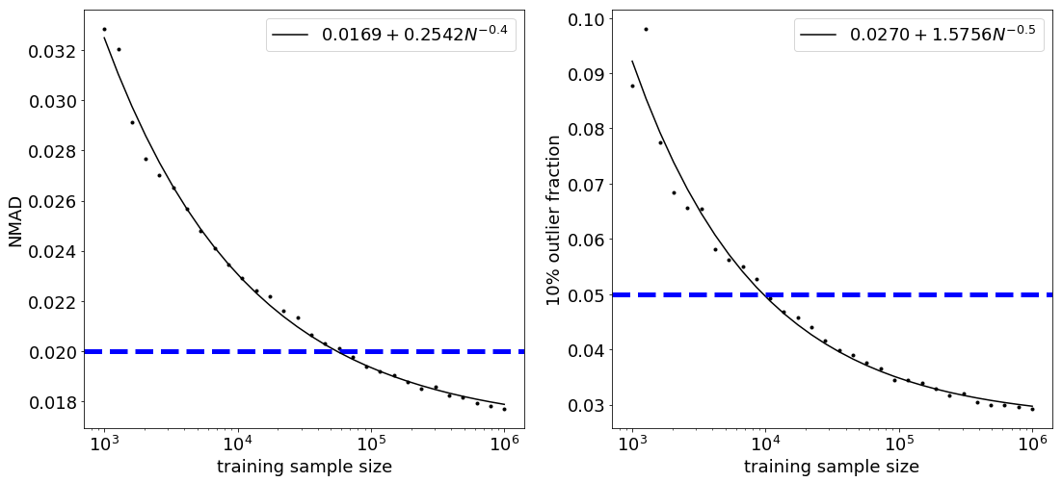
Results: k-nearest neighbors

Slide 18
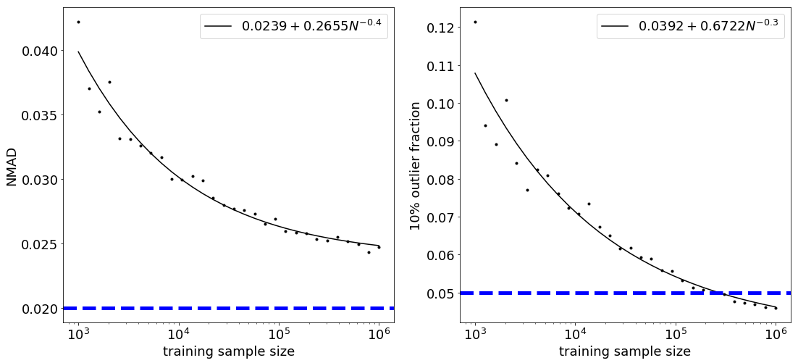
Results: XGBoost

Slide 19
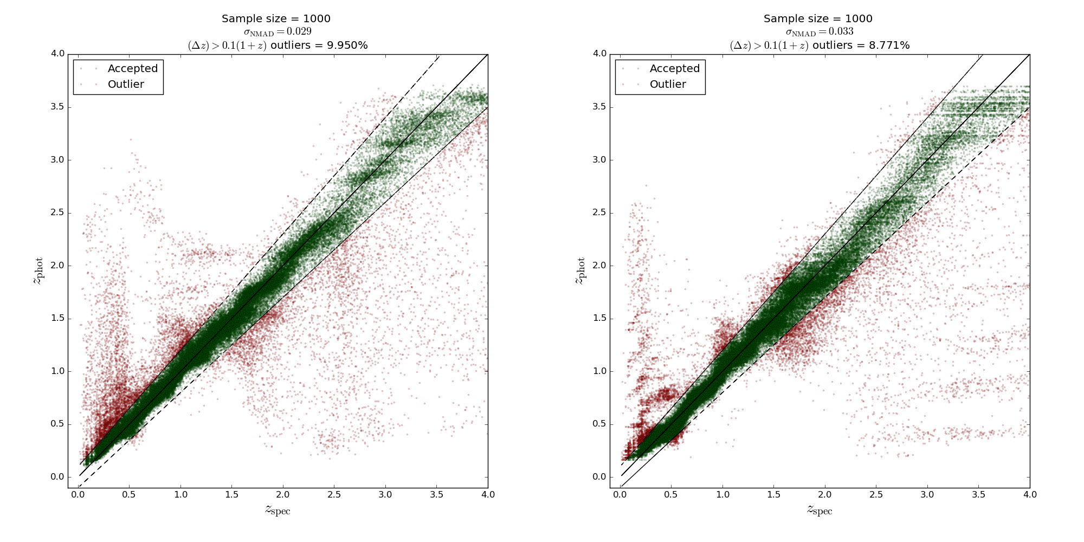
Random Forest
KNN

Slide 20
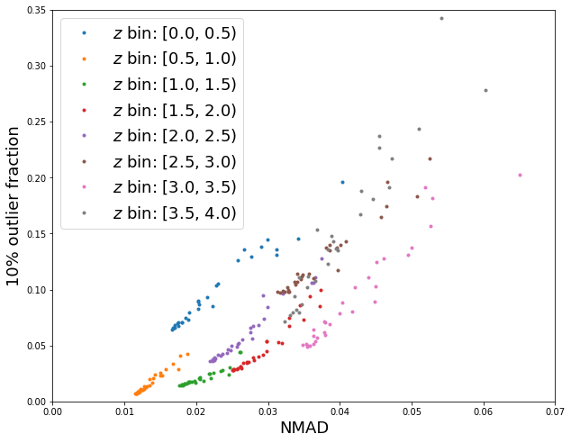
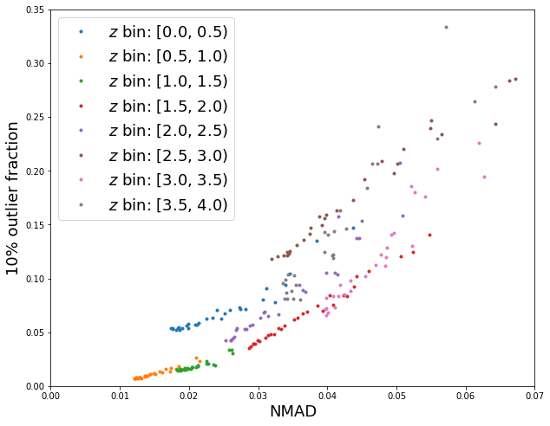
Random Forest
KNN

Slide 21
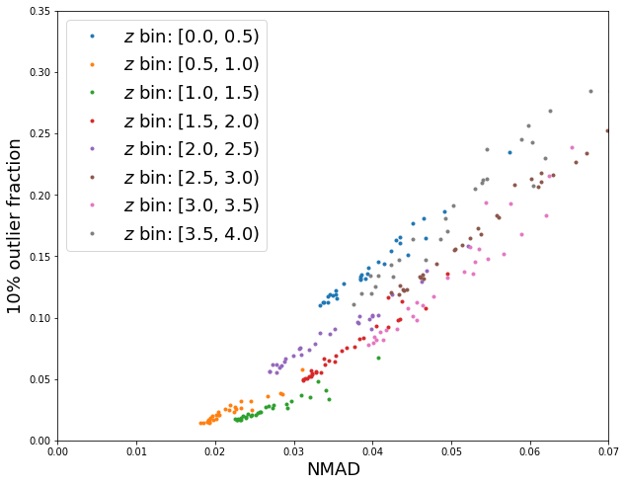
Random Forest
XGBoost

Slide 22
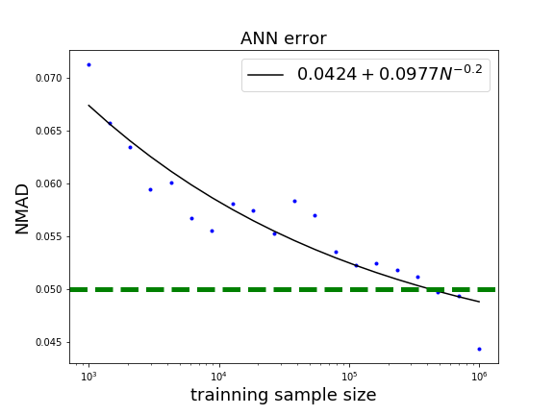
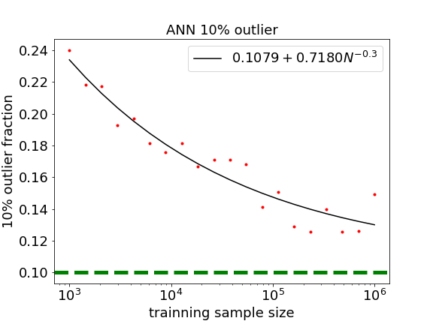
Results: Artificial neural networks (ANN)

Slide 23
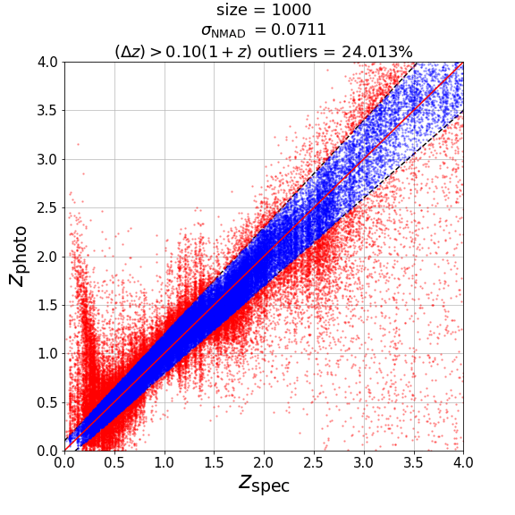
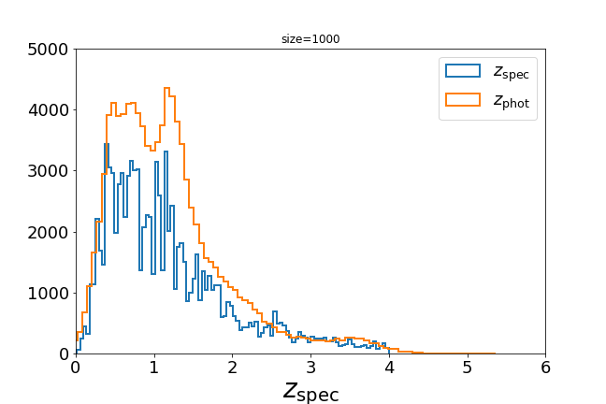
Results: Artificial neural networks (ANN)

Slide 24
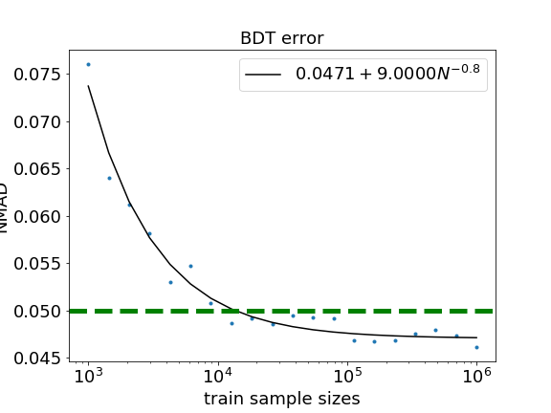
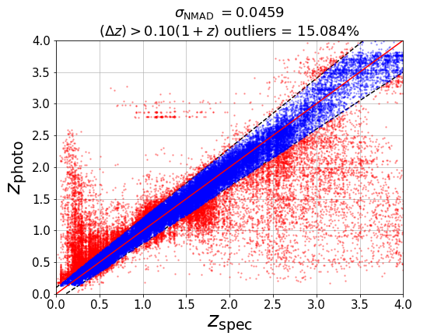
Results: Boosted decision trees (BDT)

Slide 25
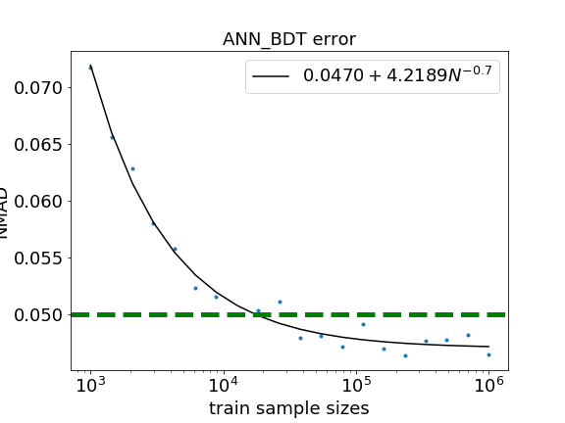
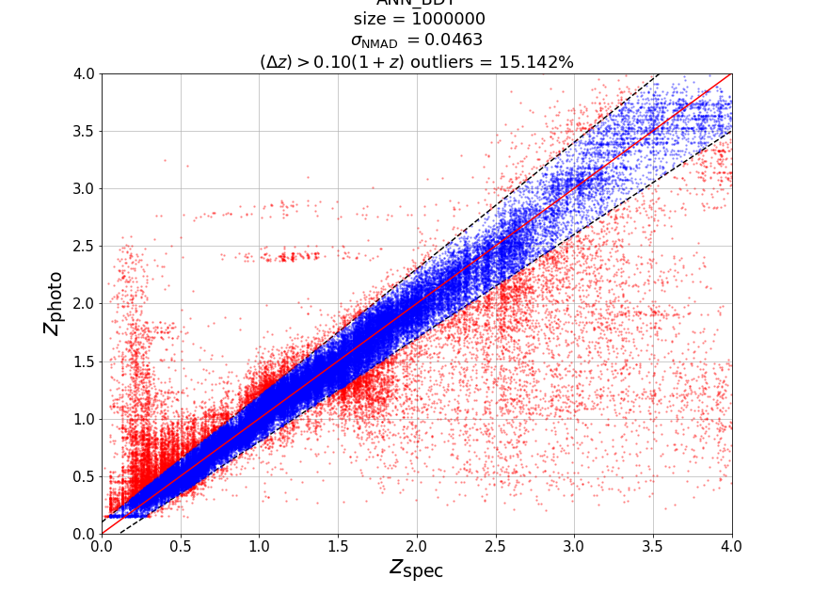
Results: ANN+BDT mixture

Slide 26
Summary
The scalings of photo-z estimation error with training sample size given by
Random forest, K-nearest neighbours and XGBoost are similar.
The scaling of photo-z estimation error with training sample size given by
ANN, BDT and their mixture are quite different.
Improve the performance of ANN?

Slide 27
Appendix

Slide 28
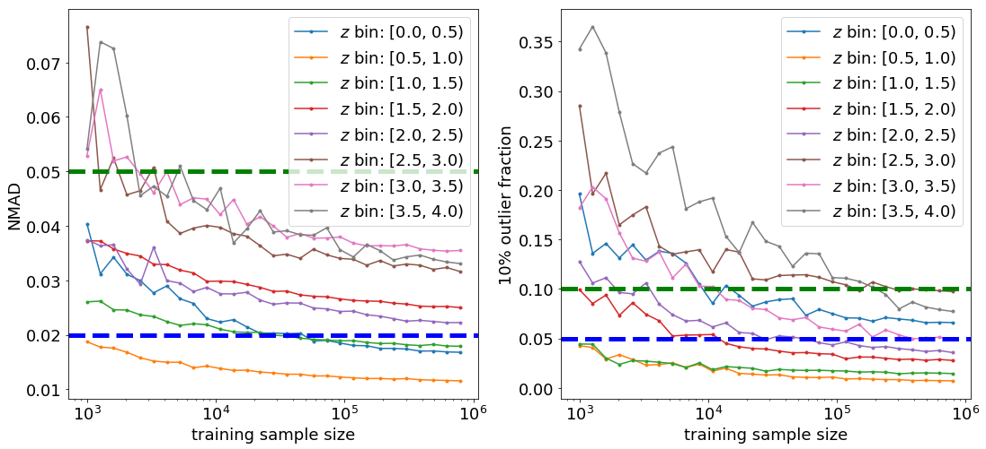
z-binned: random forest

Slide 29
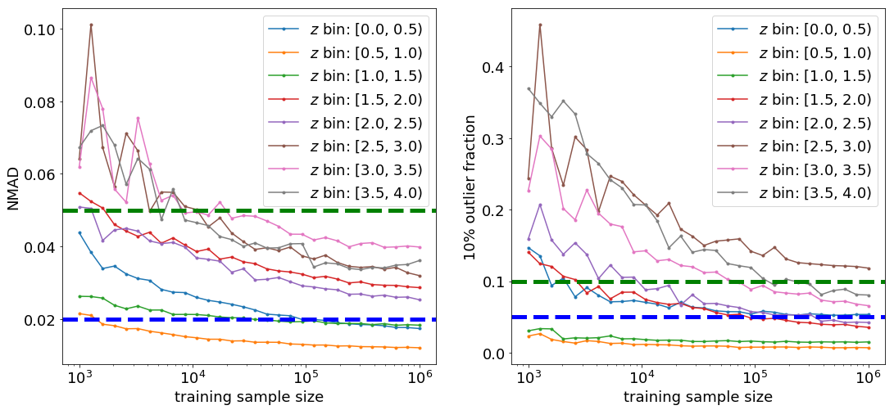
z-binned: k-nearest neighbours

Slide 30
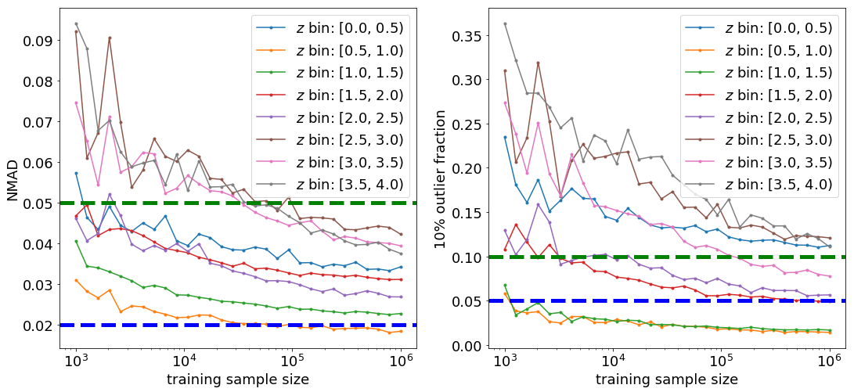
z-binned: XGBoost

Slide 31
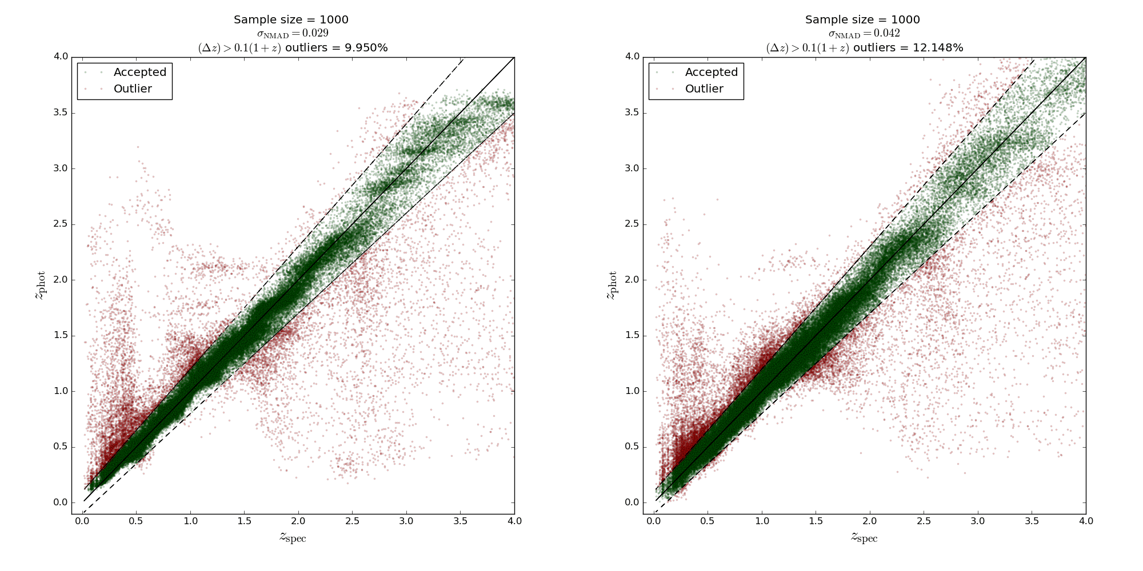
Random Forest
XGBoost

Slide 32
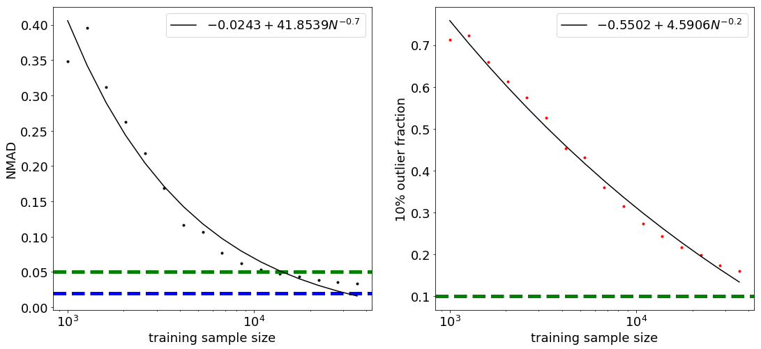
Results: Gaussian process
Work well with features in magnitudes
Require > 100 Gb memory after 10^4 training samples

